Slide 1
3D Computer Vision
Dr. Hassan Foroosh
School of EECS
UCF

Slide 2
Parameter estimation
2D homography
  Given a set of (x_{i},x_{i}’), compute H (x_{i}’=Hx_{i})
3D to 2D camera projection
  Given a set of (X_{i},x_{i}), compute P (x_{i}=PX_{i})
Fundamental matrix
  Given a set of (x_{i},x_{i}’), compute F (x_{i}’^{T}Fx_{i}=0)
Trifocal tensor
  Given a set of (x_{i},x_{i}’,x_{i}”), compute T

Slide 3
DLT algorithm
Objective
Given n≥4 2D to 2D point correspondences {x_{i}↔x_{i}’}, determine the 2D homography matrix H such that x_{i}’=Hx_{i}
Algorithm
For each correspondence x_{i} ↔x_{i}’ compute A_{i}. Usually only two first rows needed.
Assemble n 2x9 matrices A_{i} into a single 2nx9 matrix A
Obtain SVD of A. Solution for h is last column of V
Determine H from h

Slide 4



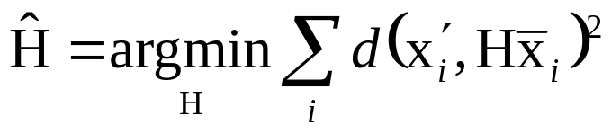
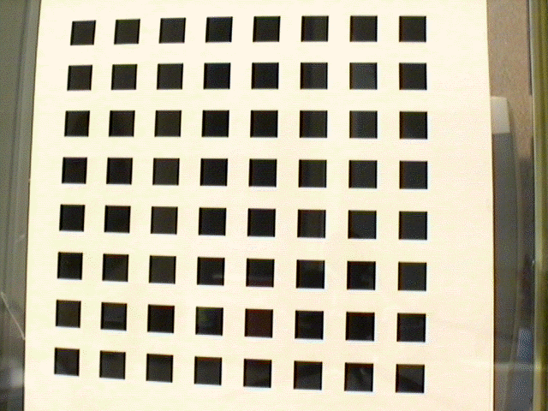
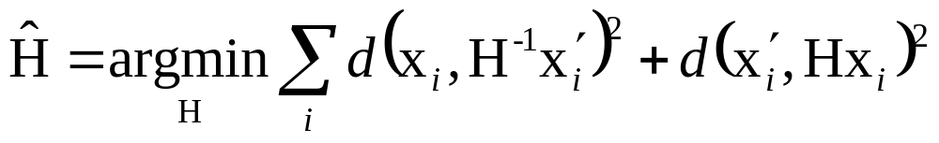
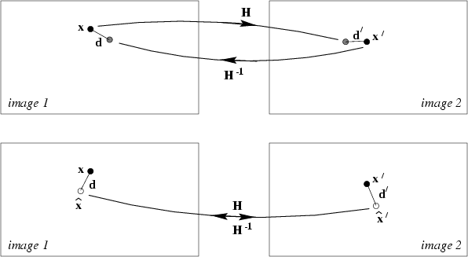
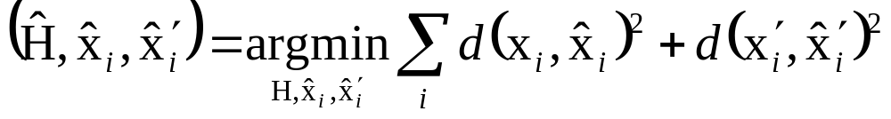
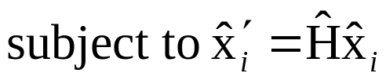
Geometric distance
measured coordinates
estimated coordinates
true coordinates
d(.,.) Euclidean distance (in image)
Error in one image
e.g. calibration pattern
Symmetric transfer error
Reprojection error

Slide 5


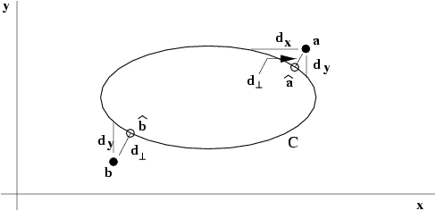


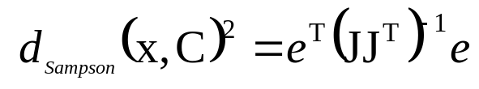
Sampson error
Estimating homography~fit surface to points X=(x,y,x’,y’)^{T} in R⁴
Analog to conic fitting
Notes:
Nonlinear, except for line fitting = affine homographies (no quadratic terms in this case!) (x,x’,y and x,y,y’) => linear solution

Slide 6
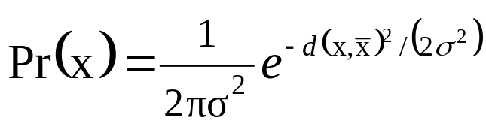
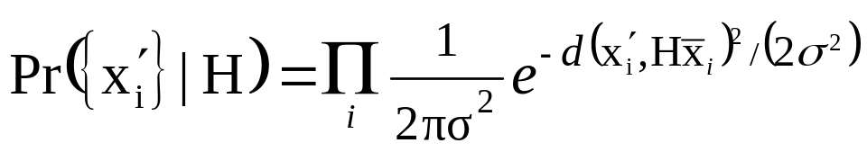

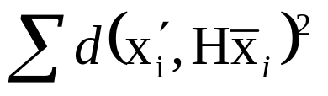
Statistical cost function and Maximum Likelihood Estimation
Optimal cost function related to noise model
Assume zero-mean isotropic Gaussian noise (assume outliers removed)
Error in one image
Maximum Likelihood Estimate

Slide 7
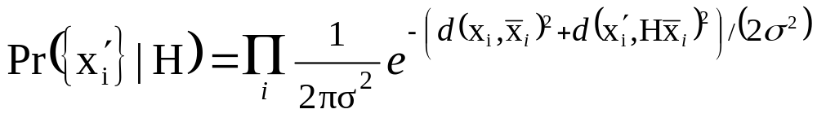
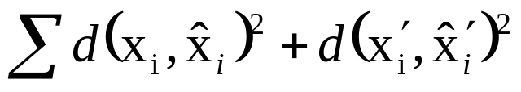
Statistical cost function and Maximum Likelihood Estimation
Optimal cost function related to noise model
Assume zero-mean isotropic Gaussian noise (assume outliers removed)
Error in both images
Maximum Likelihood Estimate

Slide 8
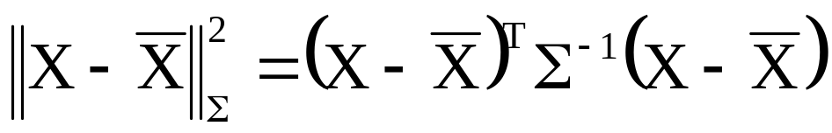
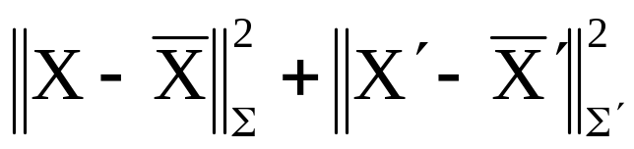
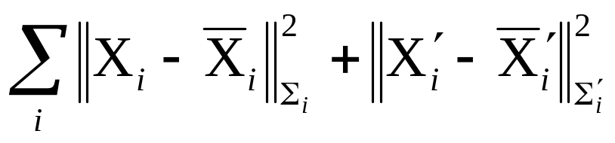
Mahalanobis distance
General Gaussian case
Measurement X with covariance matrix Σ
Error in two images (independent)
Varying covariances

Slide 9

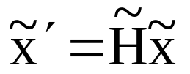


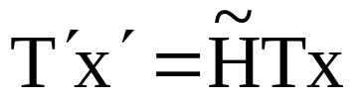
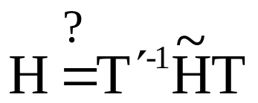
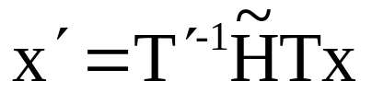
Invariance to transforms ?
will result change?
for which algorithms? for which transformations?

Slide 10



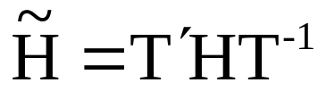
Non-invariance of DLT
Given and H computed by DLT,
and
Does the DLT algorithm applied to
yield ?

Slide 11
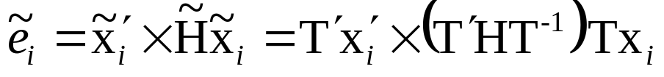
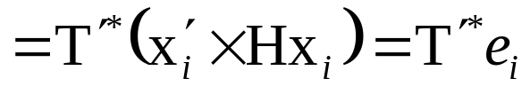
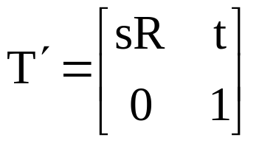
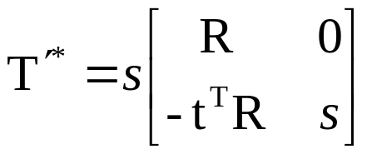
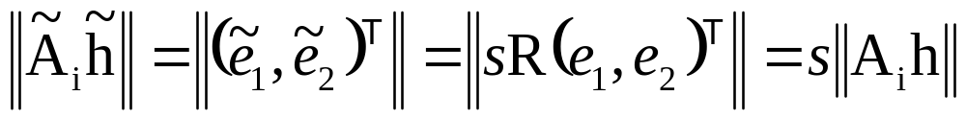
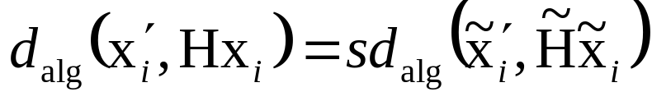
Effect of change of coordinates on algebraic error
for similarities
so

Slide 12
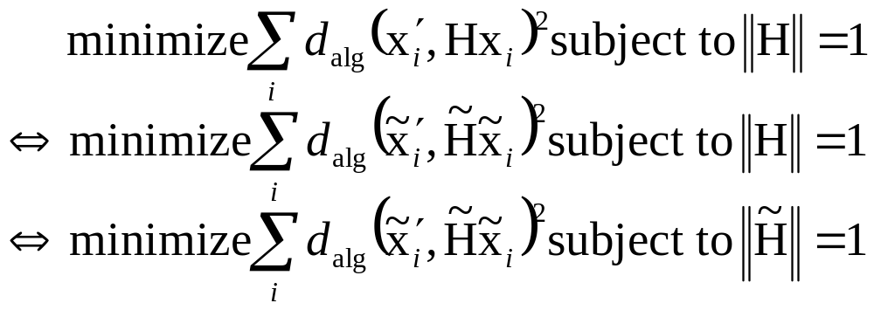
Non-invariance of DLT
Given and H computed by DLT,
and
Does the DLT algorithm applied to
yield ?

Slide 13


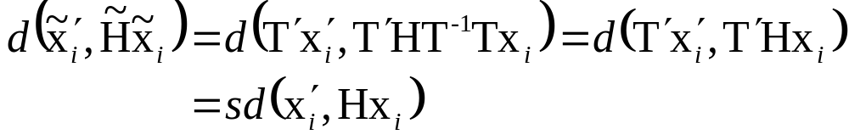
Invariance of geometric error
Given and H,
and
Assume T’ is a similarity transformations

Slide 14

Normalizing Transformations
Since DLT is not invariant,
what is a good choice of coordinates?
  e.g.
  Translate centroid to origin
  Scale to a average distance to the origin
  Independently on both images

Slide 15
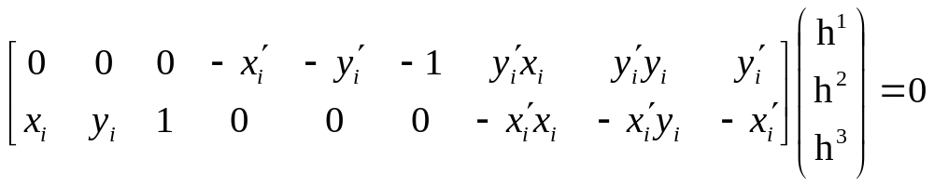
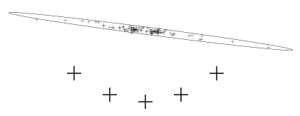
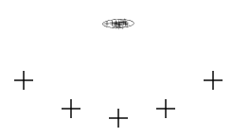
Importance of normalization
~10²
~10²
1
~10²
~10²
1
~10⁴
~10⁴
~10²
orders of magnitude difference!

Slide 16

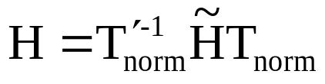
Normalized DLT algorithm
Objective
Given n≥4 2D to 2D point correspondences {x_{i}↔x_{i}’}, determine the 2D homography matrix H such that x_{i}’=Hx_{i}
Algorithm
Normalize points
Apply DLT algorithm to
Denormalize solution

Slide 17
Iterative minimization metods
Required to minimize geometric error
Often slower than DLT
Require initialization
No guaranteed convergence, local minima
Stopping criterion required
Therefore, careful implementation required:
Cost function
Parameterization (minimal or not)
Cost function ( parameters )
Initialization
Iterations

Slide 18
Parameterization
Parameters should cover complete space and allow efficient estimation of cost
  Minimal or over-parameterized? e.g. 8 or 9
  (minimal often more complex, also cost surface)
  (good algorithms can deal with over-parameterization)
  (sometimes also local parameterization)
  Parametrization can also be used to restrict transformation to particular class, e.g. affine

Slide 19
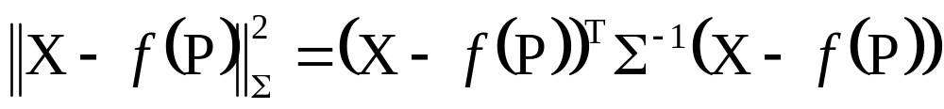

Function specifications
Measurement vector X∈R^{N} with covariance Σ
Set of parameters represented by vector P ∈R^{N}
Mapping f : R^{M} →R^{N}. Range of mapping is surface S representing allowable measurements
Cost function: squared Mahalanobis distance
Goal is to achieve , or get as close as
possible in terms of Mahalanobis distance

Slide 20

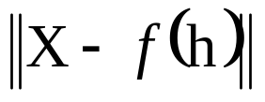
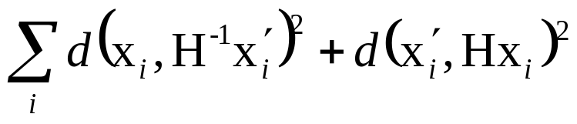

Error in one image
Symmetric transfer
error
Reprojection error

Slide 21
Initialization
Typically, use linear solution
If outliers, use robust algorithm
Alternative, sample parameter space

Slide 22
Iteration methods
Many algorithms exist
Newton’s method
Levenberg-Marquardt
Powell’s method
Simplex method

Slide 23

Gold Standard algorithm
Objective
Given n≥4 2D to 2D point correspondences {x_{i}↔x_{i}’}, determine the Maximum Likelyhood Estimation of H
(this also implies computing optimal x_{i}’=Hx_{i})
Algorithm
Initialization: compute an initial estimate using normalized DLT or RANSAC
Geometric minimization of -Either Sampson error:
  ● Minimize the Sampson error
  ● Minimize using Levenberg-Marquardt over 9 entries of h
  or Gold Standard error:
  ● compute initial estimate for optimal {x_{i}}
  ● minimize cost over {H,x₁,x₂,…,x_{n}}
  ● if many points, use sparse method

Slide 24
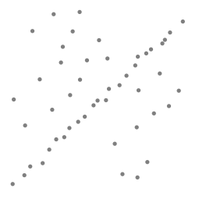
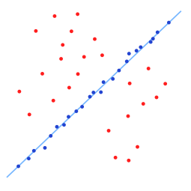
Robust estimation
What if set of matches contains gross outliers?

Slide 25
RANSAC
(Random Sample Consensus)
Objective
Robust fit of model to data set S which contains outliers
Algorithm
Randomly select a sample of s data points from S and instantiate the model from this subset.
Determine the set of data points S_{i} which are within a distance threshold t of the model. The set S_{i} is the consensus set of samples and defines the inliers of S.
If the subset of S_{i} is greater than some threshold T, re-estimate the model using all the points in S_{i} and terminate
If the size of S_{i} is less than T, select a new subset and repeat the above.
After N trials the largest consensus set S_{i} is selected, and the model is re-estimated using all the points in the subset S_{i}

Slide 26

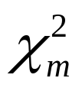
Distance threshold
Choose t so probability for inlier is α (e.g. 0.95)
Often empirically
Zero-mean Gaussian noise σ then follows
distribution

Slide 27
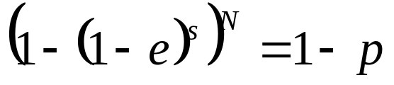
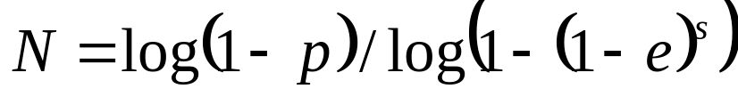
How many samples?
Choose N so that, with probability p, at least one random sample is free from outliers. e.g. p=0.99
 | proportion of outliers e
s | 5% | 10% | 20% | 25% | 30% | 40% | 50%
2 | 2 | 3 | 5 | 6 | 7 | 11 | 17
3 | 3 | 4 | 7 | 9 | 11 | 19 | 35
4 | 3 | 5 | 9 | 13 | 17 | 34 | 72
5 | 4 | 6 | 12 | 17 | 26 | 57 | 146
6 | 4 | 7 | 16 | 24 | 37 | 97 | 293
7 | 4 | 8 | 20 | 33 | 54 | 163 | 588
8 | 5 | 9 | 26 | 44 | 78 | 272 | 1177

Slide 28

Acceptable consensus set?
Typically, terminate when size of the consensus set is similar to the ratio of inliers
For n data points
Adaptively determining the number of samples
  e is often unknown a priori, so pick worst case, e.g. 50%, and adapt if more inliers are found, e.g. 80% would yield e=0.2

Slide 29
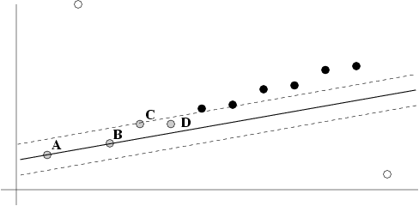
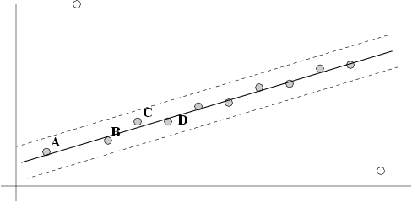
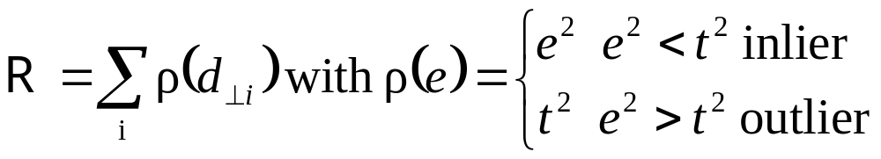
Robust ML Estimation
Previous MLE algorithm considers fixed set of inliers
Better, robust cost function (reclassifies)

Slide 30
Other robust algorithms
RANSAC maximizes number of inliers
LMedS minimizes median error
Huber function
Truncated quadratic

Slide 31
Automatic computation of H
Objective
Compute homography between two images
Algorithm
Interest points: Compute interest points in each image
Putative correspondences: Compute a set of interest point matches based on some similarity measure
RANSAC robust estimation: Repeat for N samples
(a) Select 4 correspondences and compute H
(b) Calculate the distance d⊥ for each putative match
(c) Compute the number of inliers consistent with H (d⊥<t)
Choose H with most inliers
Optimal estimation: re-estimate H from all inliers by minimizing ML cost function with Levenberg-Marquardt
Guided matching: Determine more matches using prediction by computed H
Optionally iterate last two steps until convergence

Slide 32
Determine putative correspondences
Compare interest points
  Similarity measure:
  SAD, SSD, NCC on small neighborhood
If motion is limited, only consider interest points with similar coordinates
More advanced approaches exist, based on invariance…

Slide 33
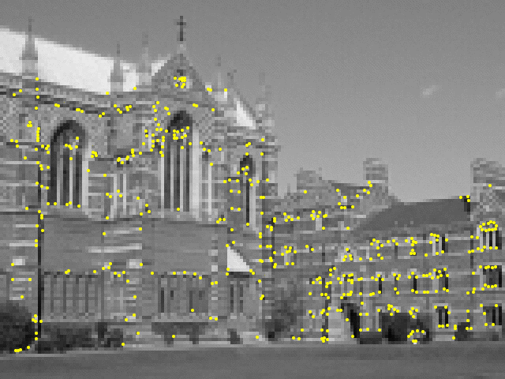
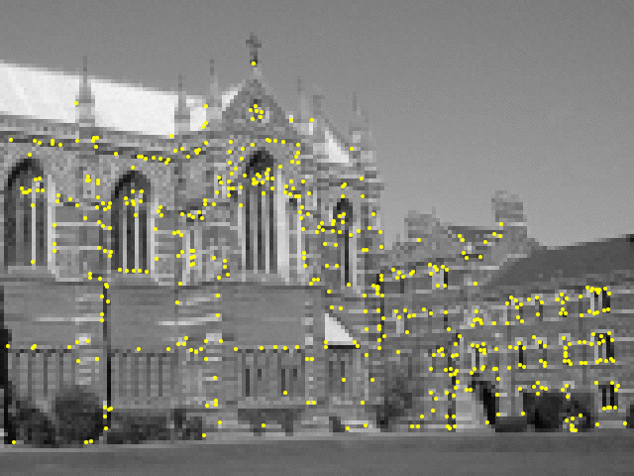
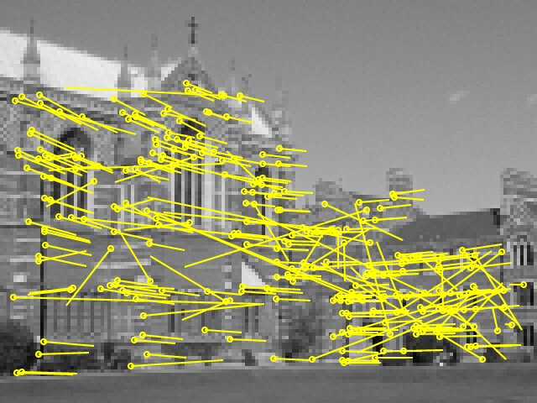
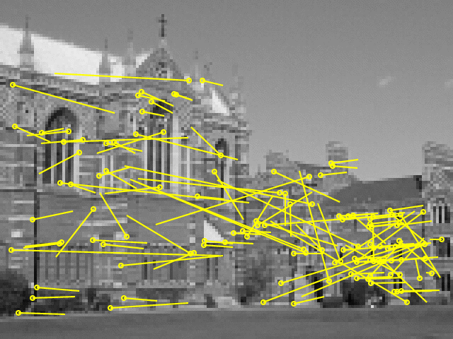
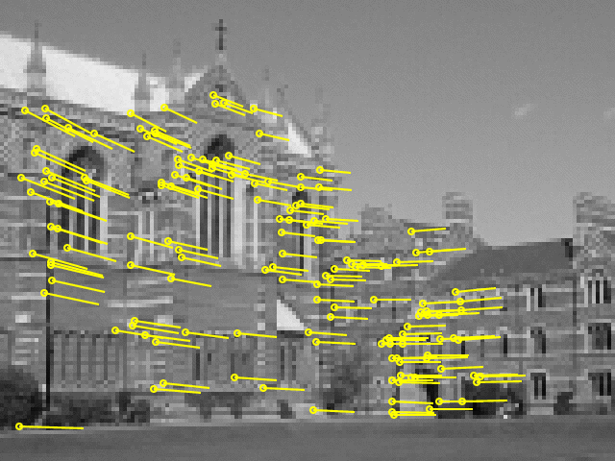
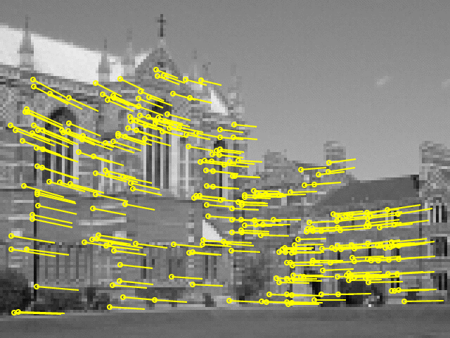
Example: robust computation
Interest points
(500/image)
Putative correspondences (268)
Outliers (117)
Inliers (151)
Final inliers (262)

